Slide 1
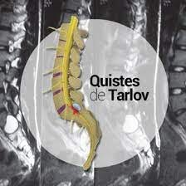

Slide 8
https://rarediseases.info.nih.gov/espanol/12006/quiste-de-tarlov
https://www.cancercarewny.com/content.aspx?chunkiid=527290
https://www.blogdehla.es/quistes-de-tarlov-que-son-diagnostico-tratamiento/

