Slide 2
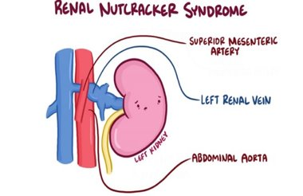

Slide 10
https://www.topdoctors.es/diccionario-medico/sindrome-de-nutcracker
https://scielo.isciii.es/scielo.php?script=sci_arttext&pid=S0210-48062003000900011
https://www.orpha.net/consor/cgi-bin/OC_Exp.php?lng=ES&Expert=71273
https://www.noticiasensalud.com/cirugia/2020/06/20/el-sindrome-de-cascanueces-como-se-trata-a-este-viejo-conocido/
https://rarediseases.info.nih.gov/espanol/13285/sindrome-renal-del-cascanueces

