Slide 1


Slide 2
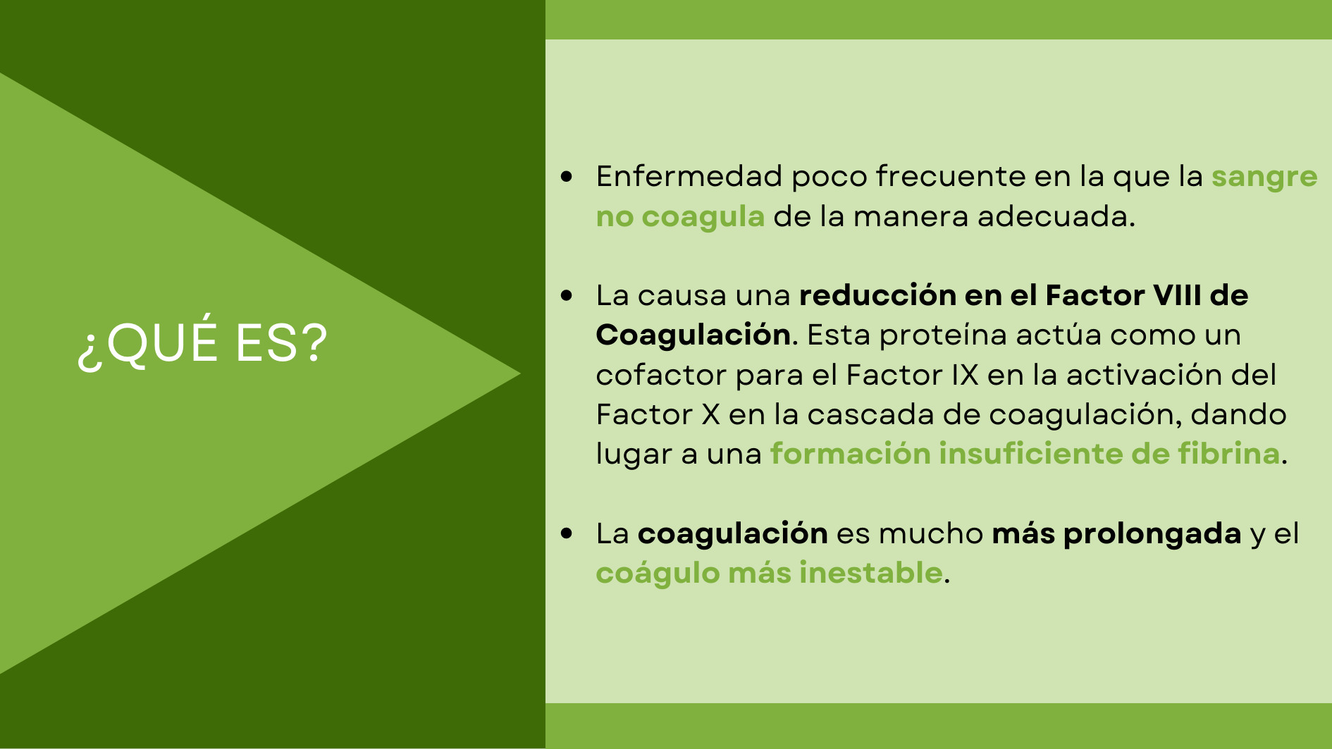

Slide 3
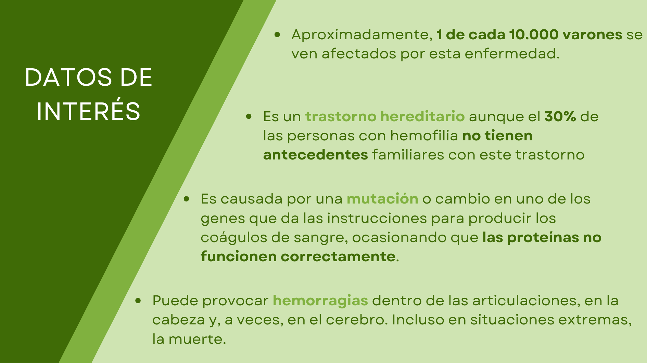

Slide 4
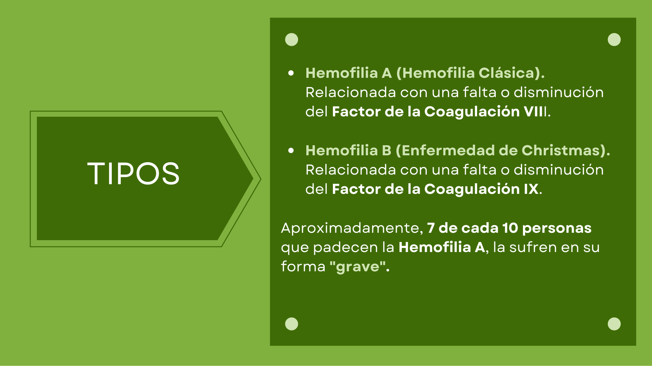

Slide 5
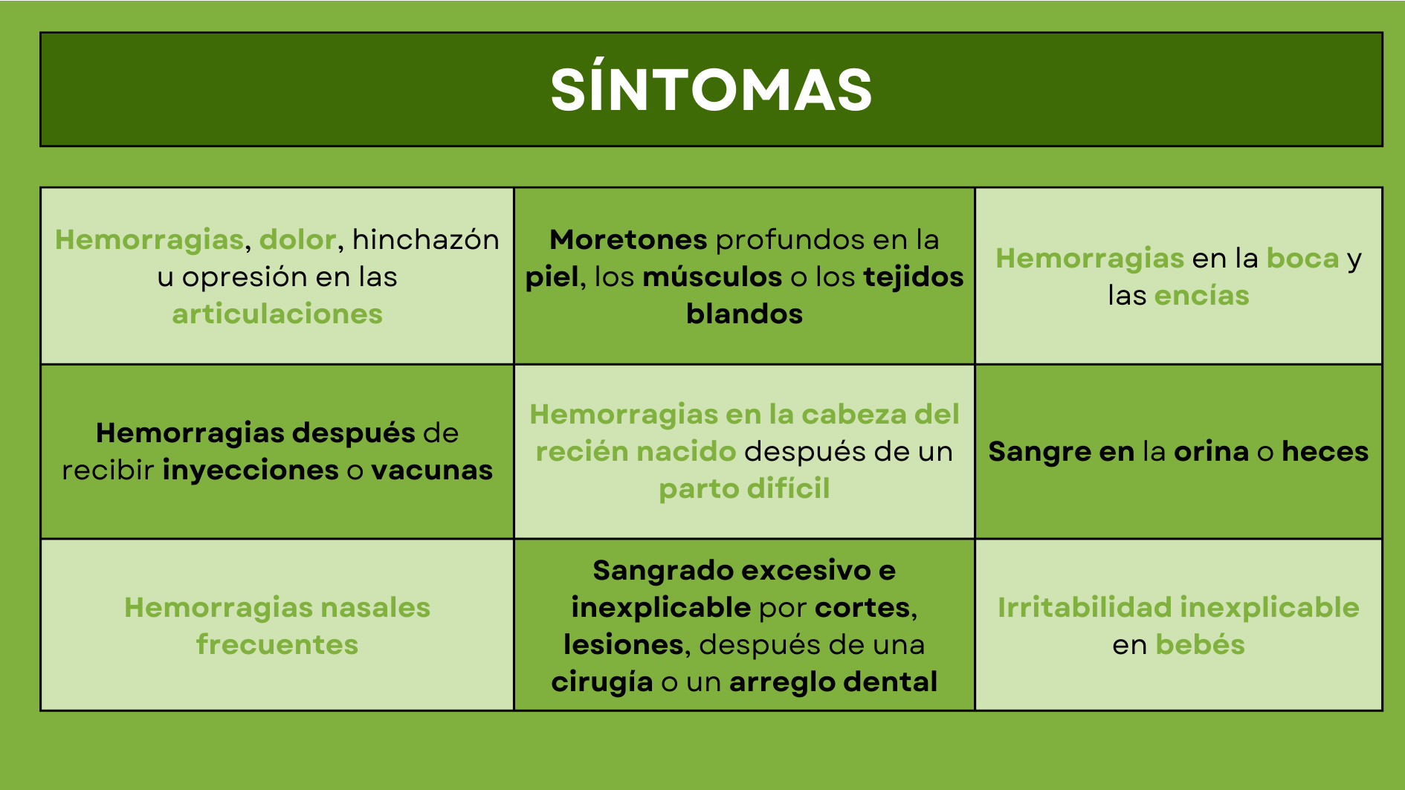

Slide 6
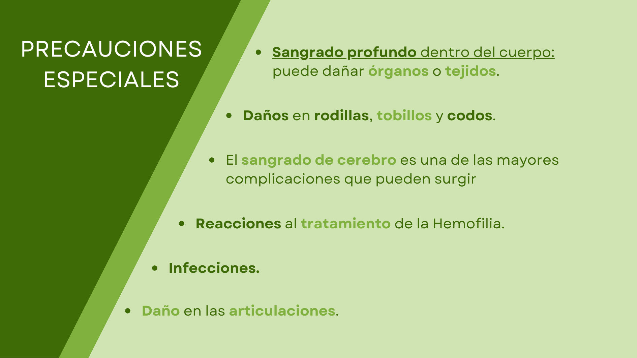

Slide 7
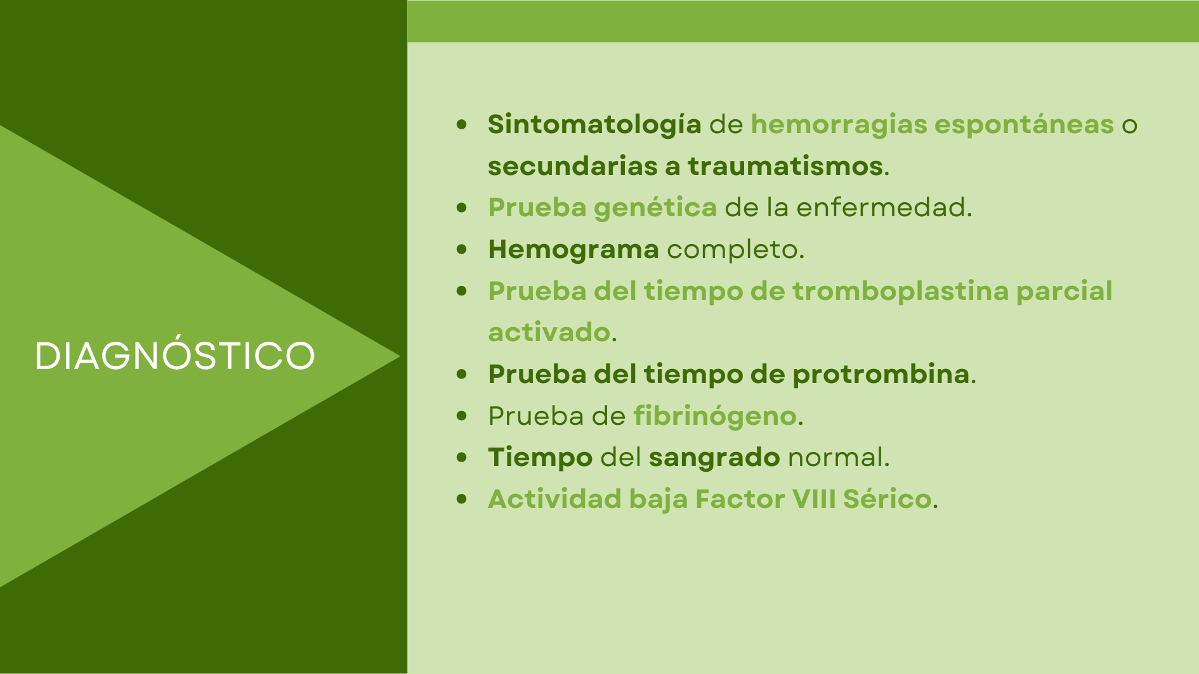

Slide 8
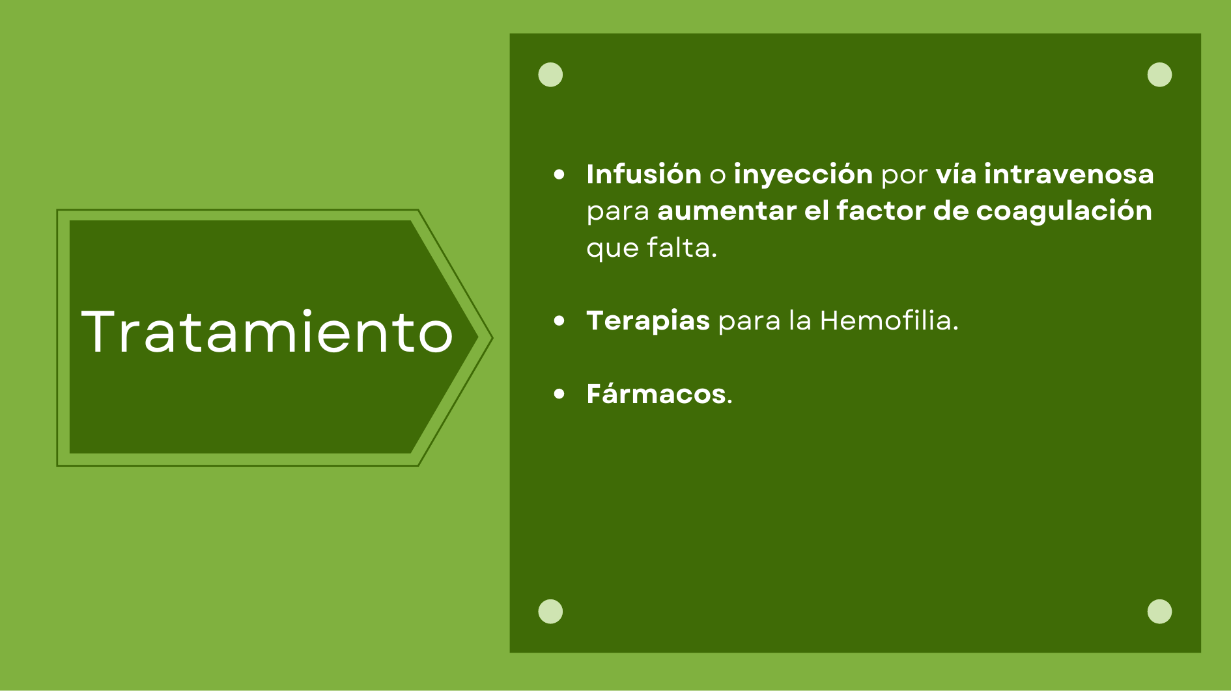

Slide 9

https://www.cdc.gov/ncbddd/Spanish/hemophilia/facts.html
https://www.mayoclinic.org/es-es/diseases-conditions/hemophilia/symptoms-causes/syc-20373327
https://www.cdc.gov/ncbddd/spanish/hemophilia/diagnosis.html
https://es.wikipedia.org/wiki/Hemofilia_A
https://www.nhlbi.nih.gov/es/salud/trastornos-hemorragicos

Slide 10
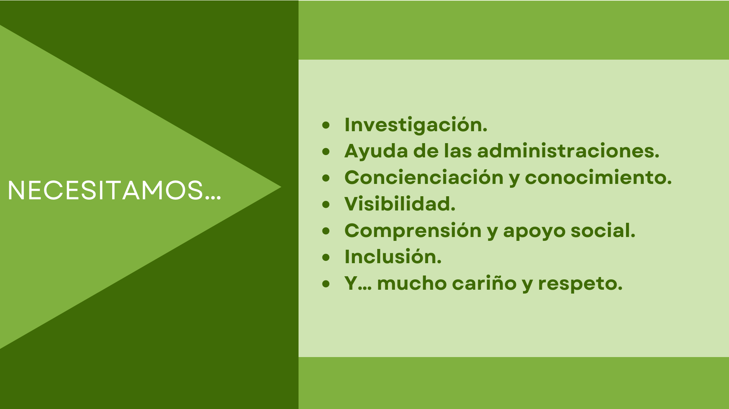

Slide 11


