Slide 1


Slide 2
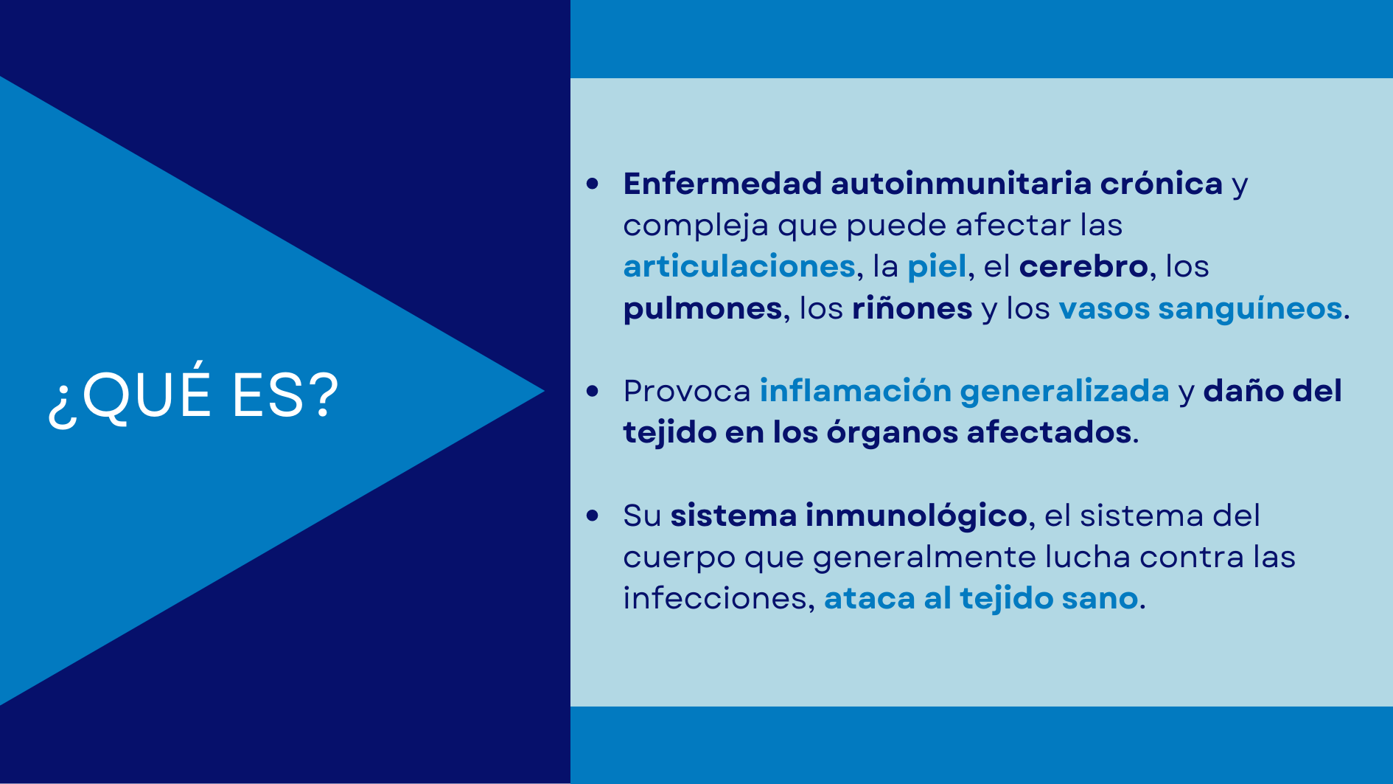

Slide 3
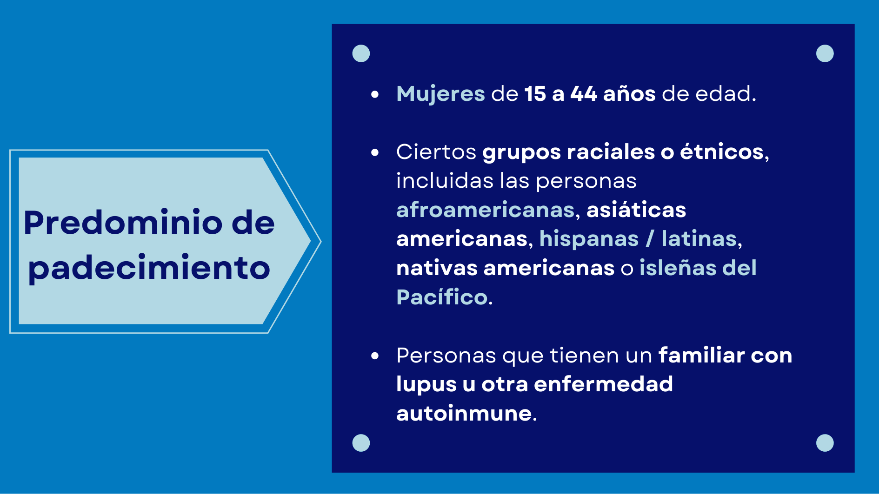

Slide 4
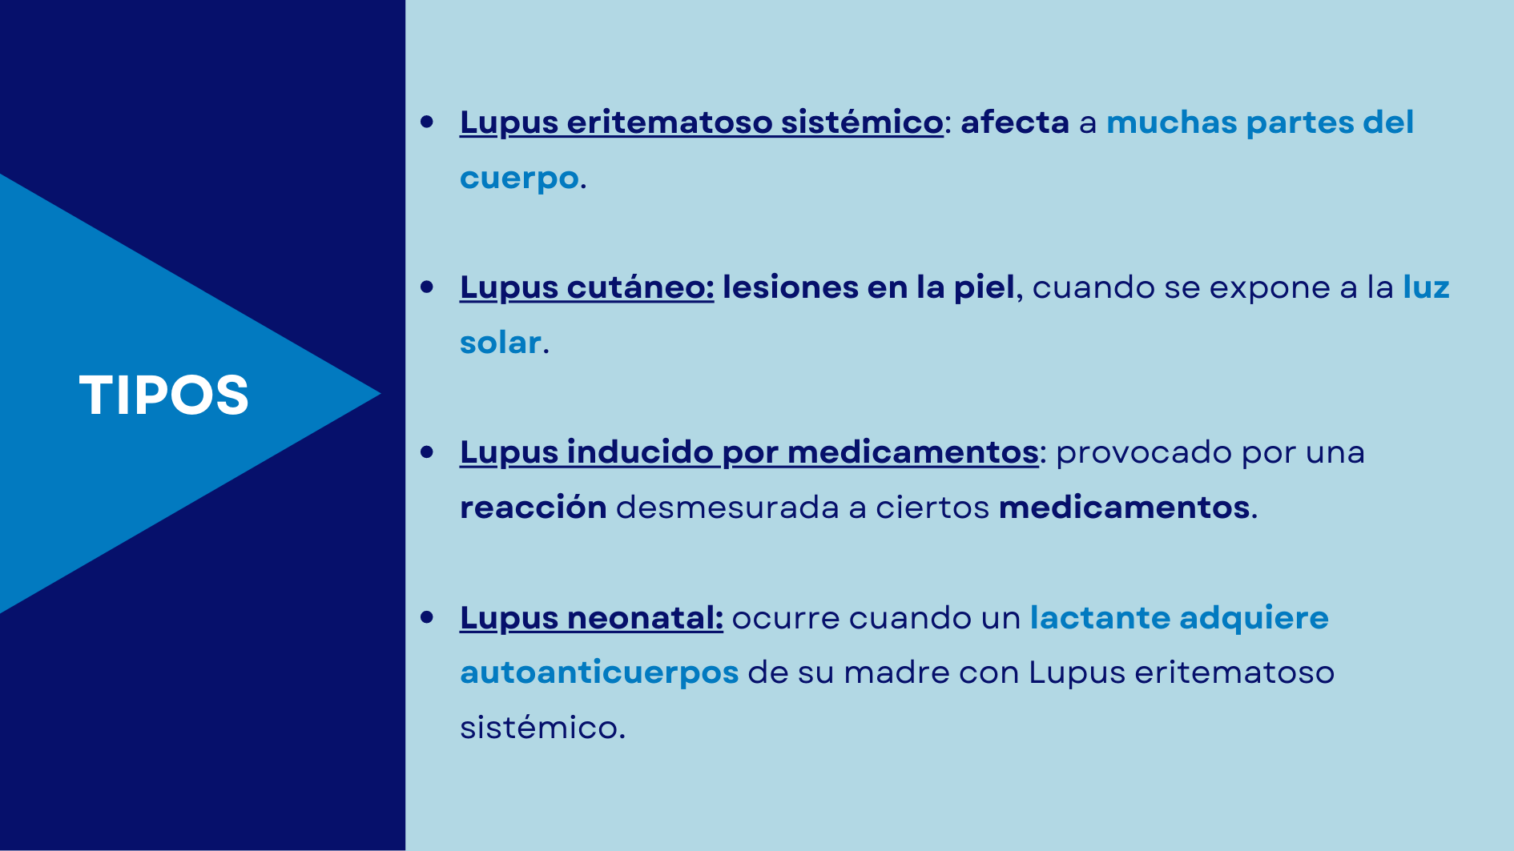

Slide 5
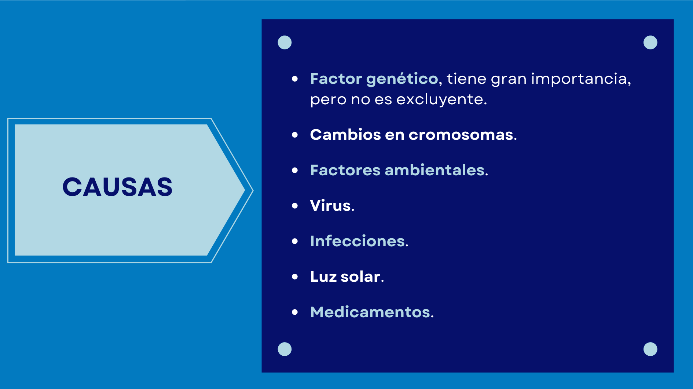

Slide 6
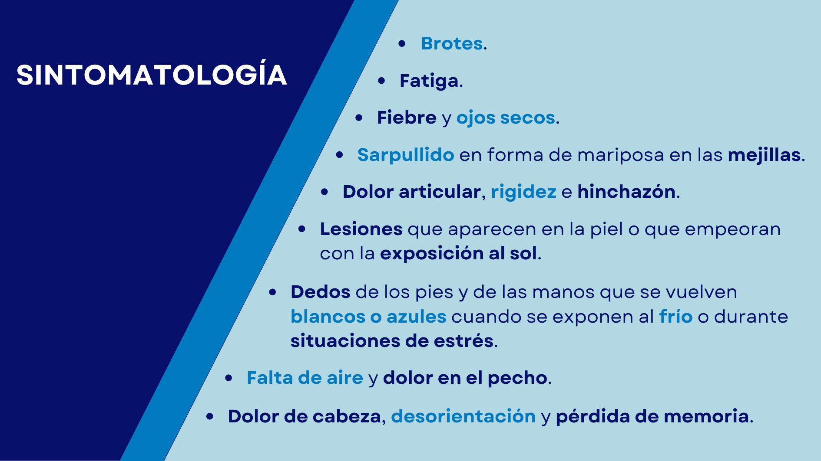

Slide 7
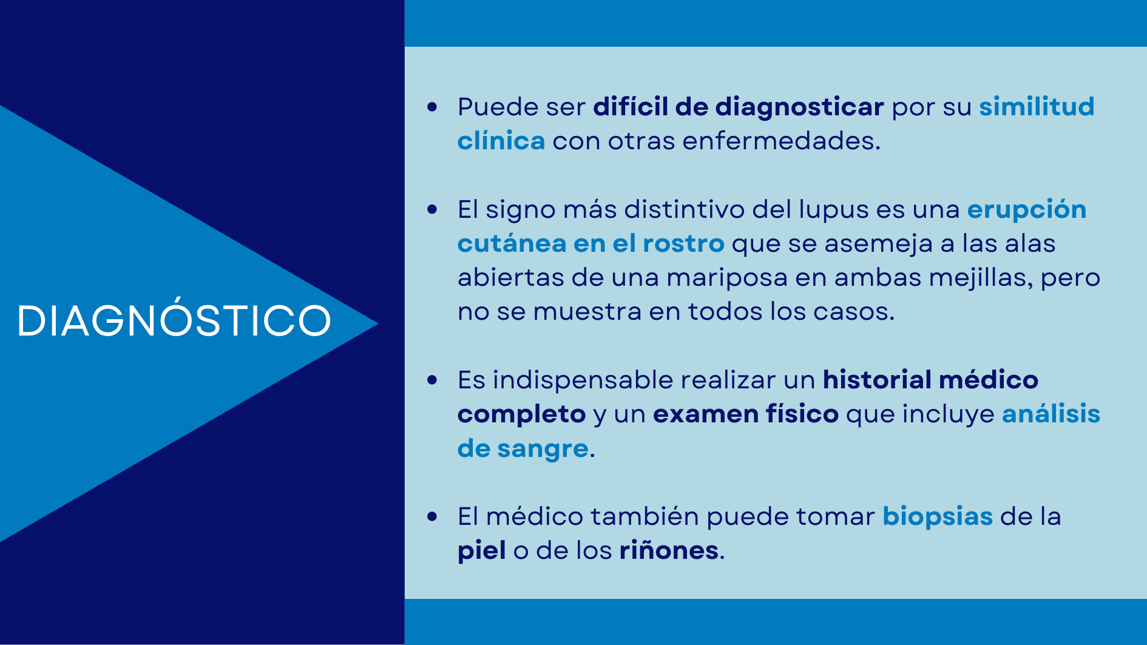

Slide 8
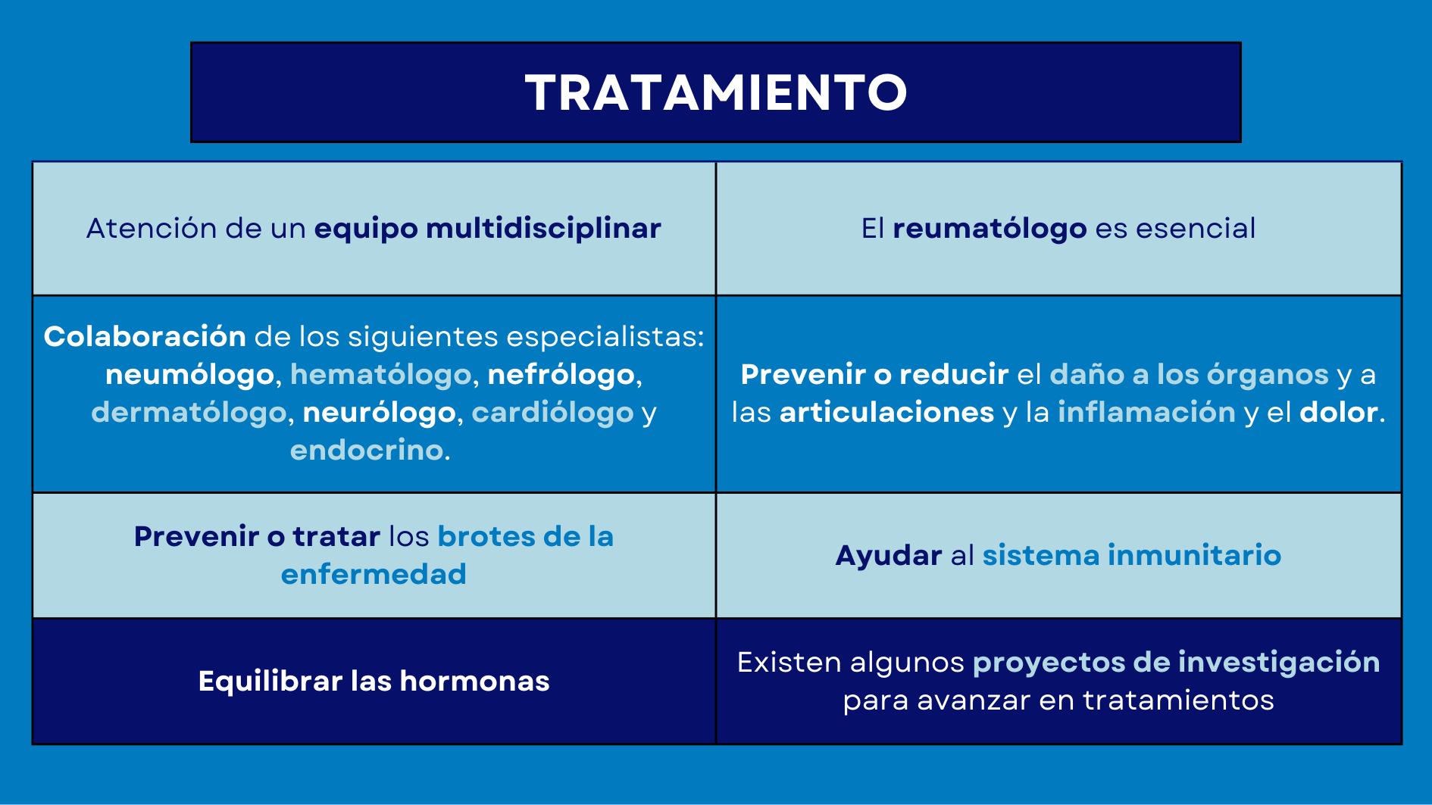

Slide 9
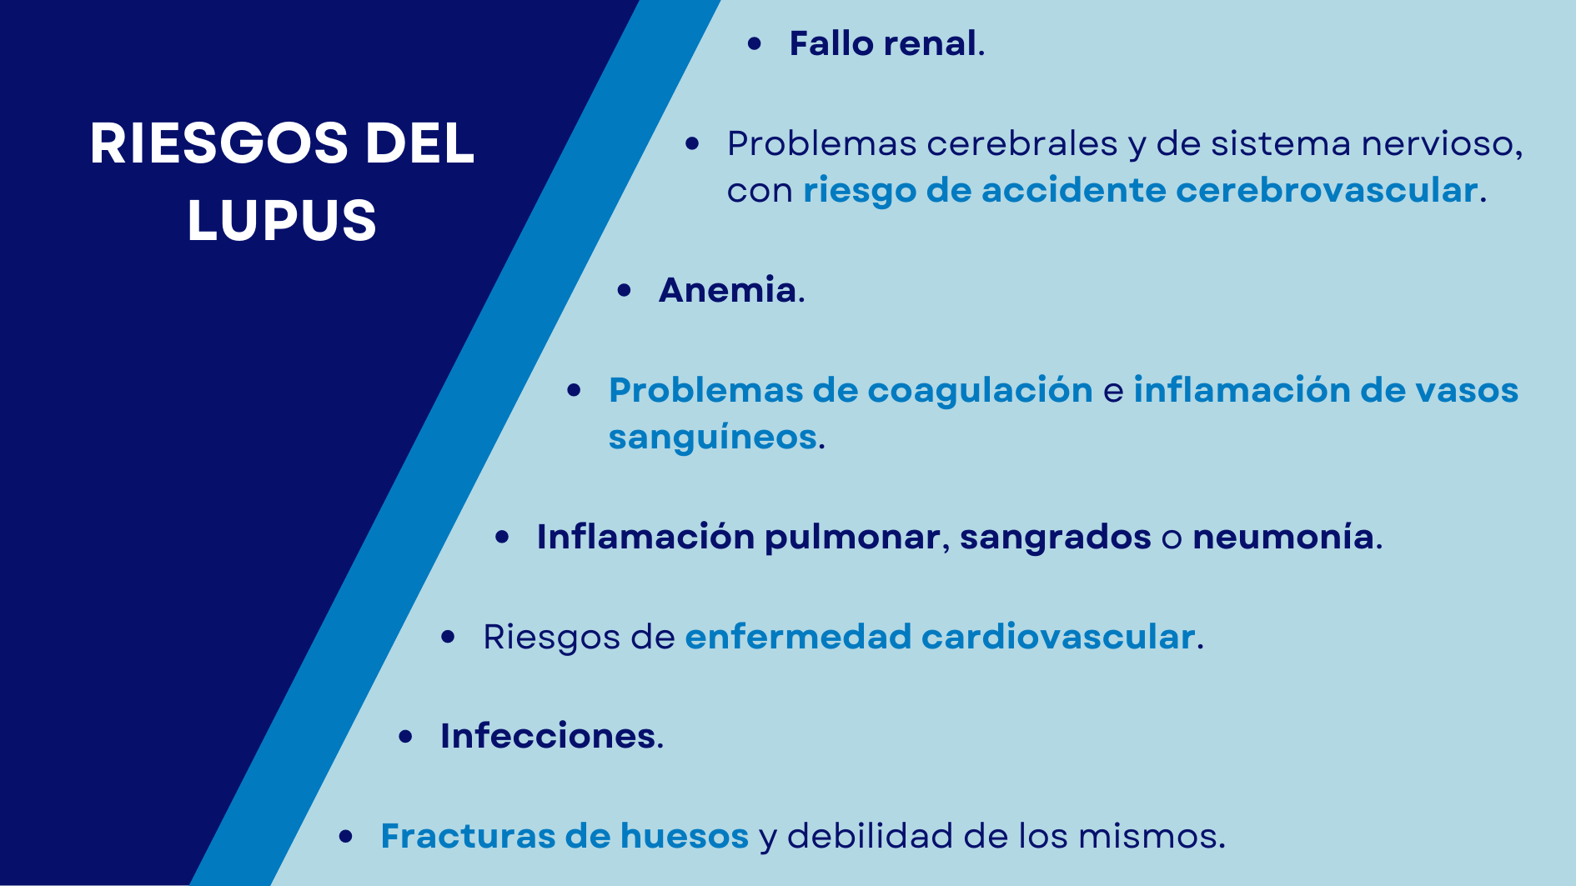

Slide 10
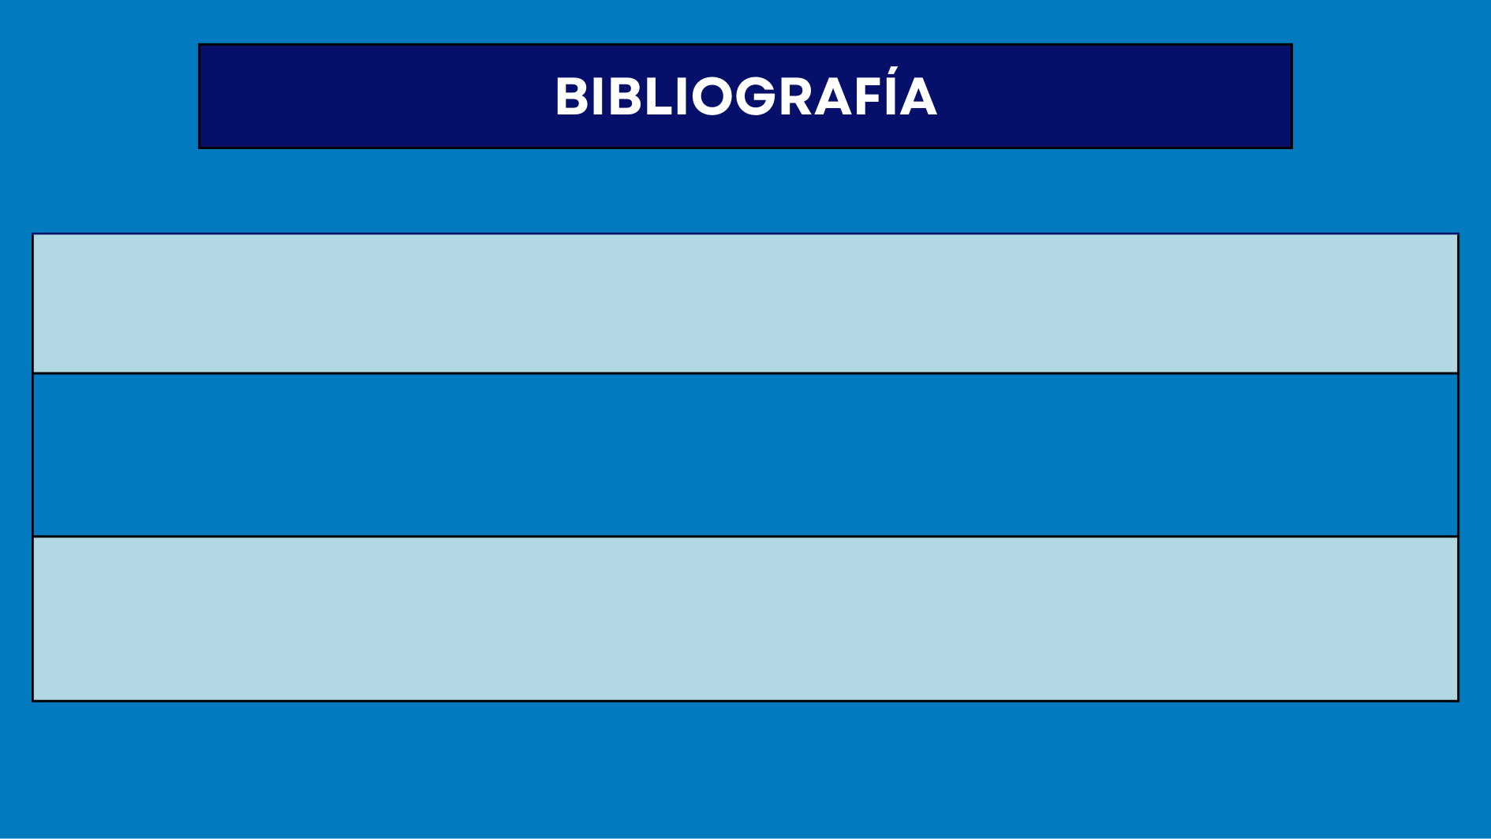
https://www.lupus.org/es/resources/que-es-el-lupus
https://www.mayoclinic.org/es-es/diseases-conditions/lupus/symptoms-causes/syc-20365789
https://www.lupusresearch.org/en-espanol/acerca-del-lupus/que-es-el-lupus/

Slide 11
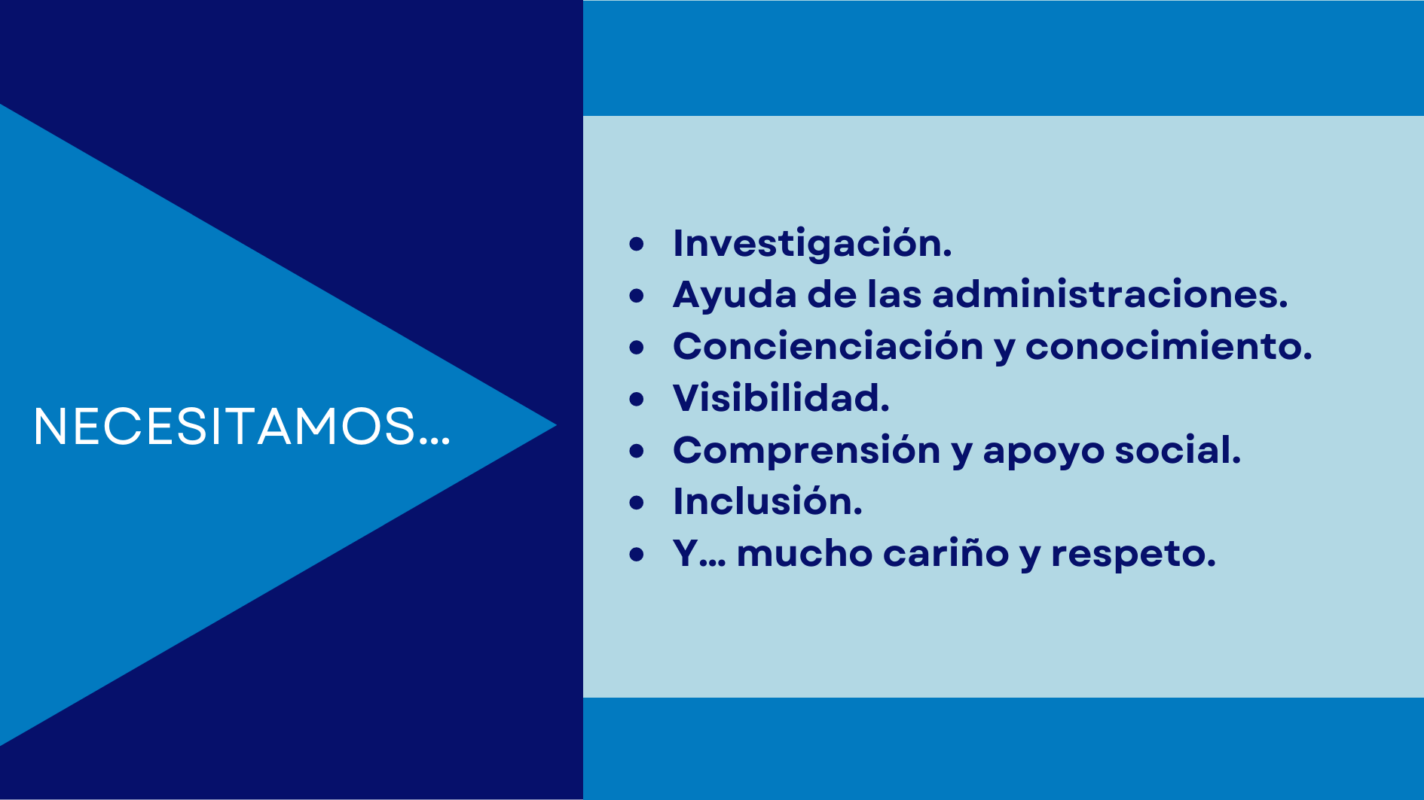

Slide 12


